Slide 1
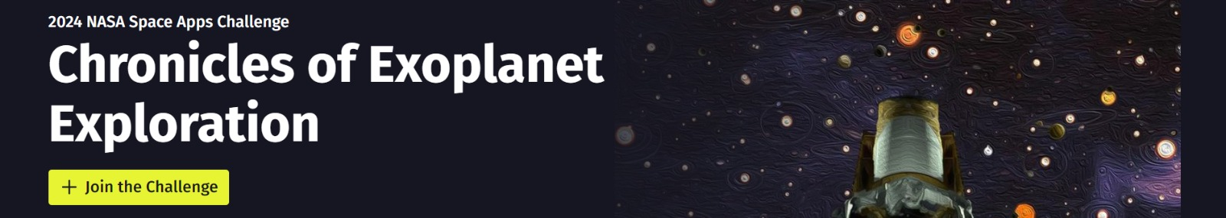
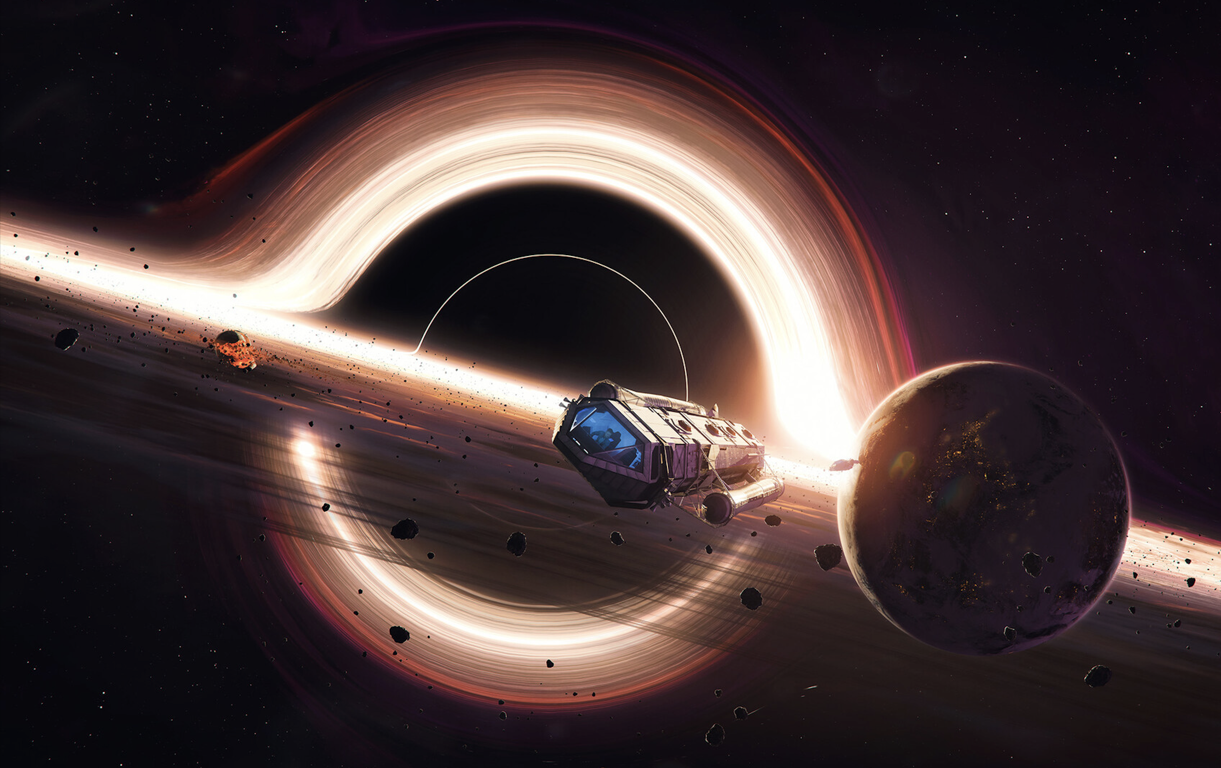
Team: Antariks Yatri 618
Chronicles of Exoplanet Exploration
Pranav Singh
Aditya Khedekar
Kunal Thakkar
Sahil Kumar
Vedant Tadla

Slide 2
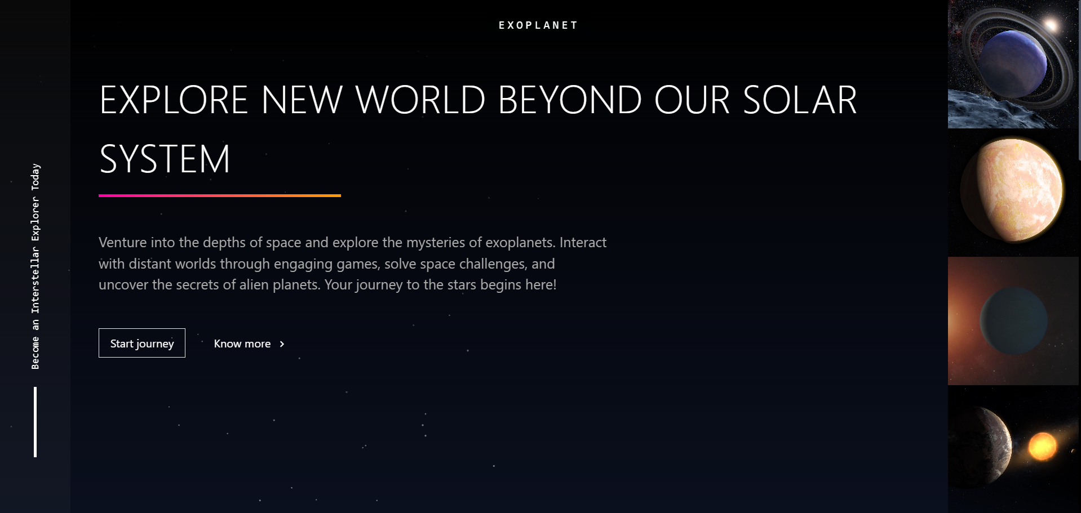
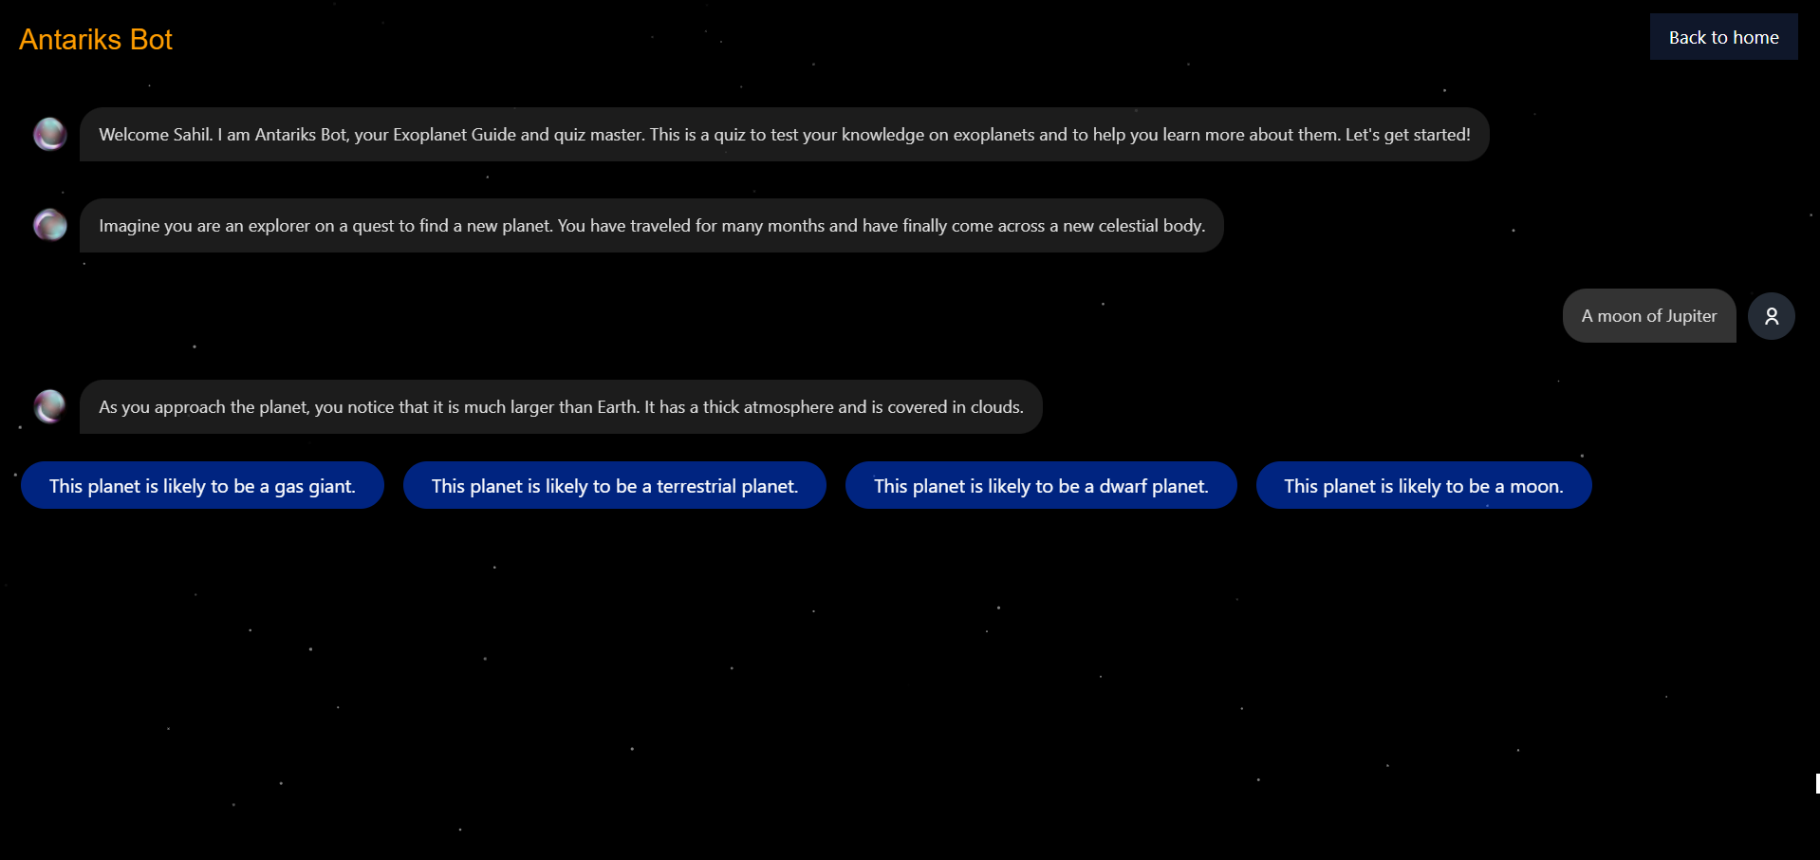


Meet Antariks Yatri ! (https://www.antariksyatri.club/)
Landing page where you click on the above link
Get started by entering age and name
Elsa – our Smart Chatbot helps you with exoplanet quiz and reszolve your douts
https://icons8.com/icons

Slide 3
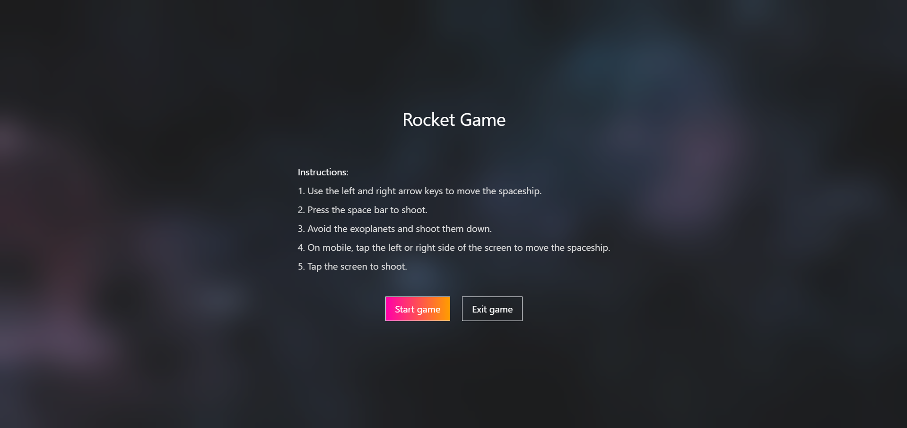
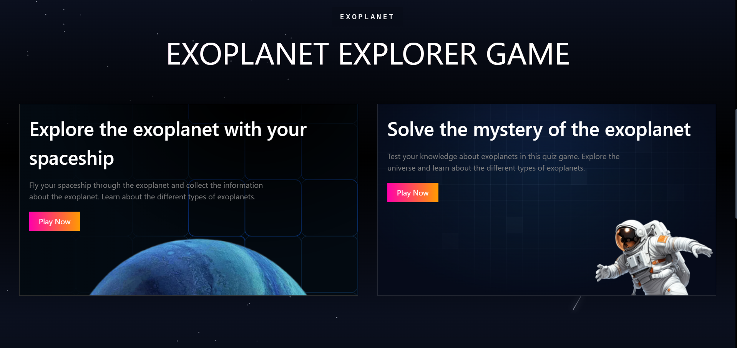
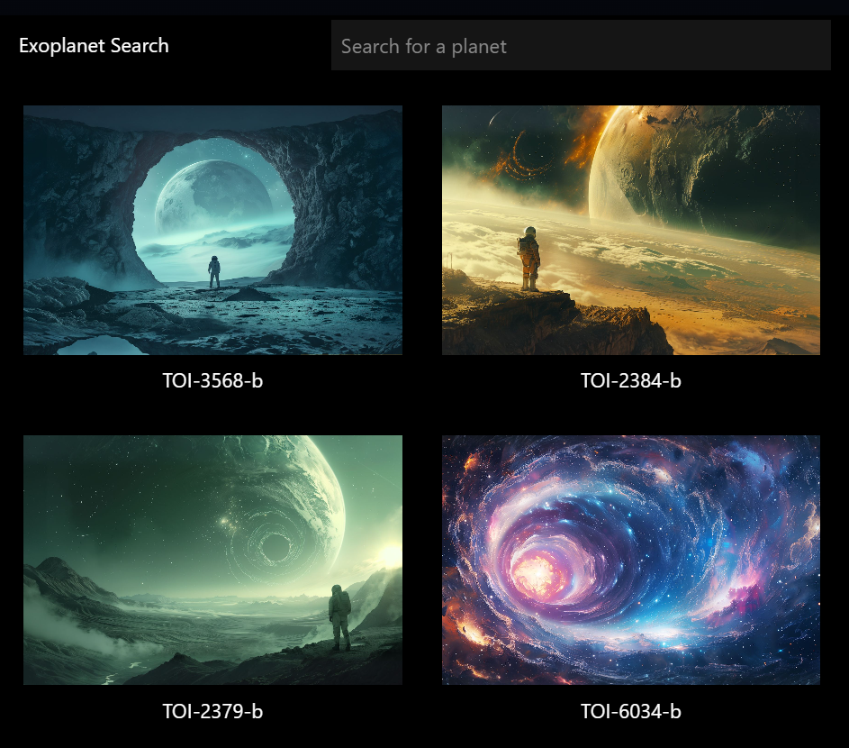
Example: Processing the Raw Data of EMIT
Target area: South Africa
Check the fun fact
A small Rocket Game
Refer to EARTH DATA 2023/09/13 13:43:55
Search for exoplanet and get more information

Slide 4
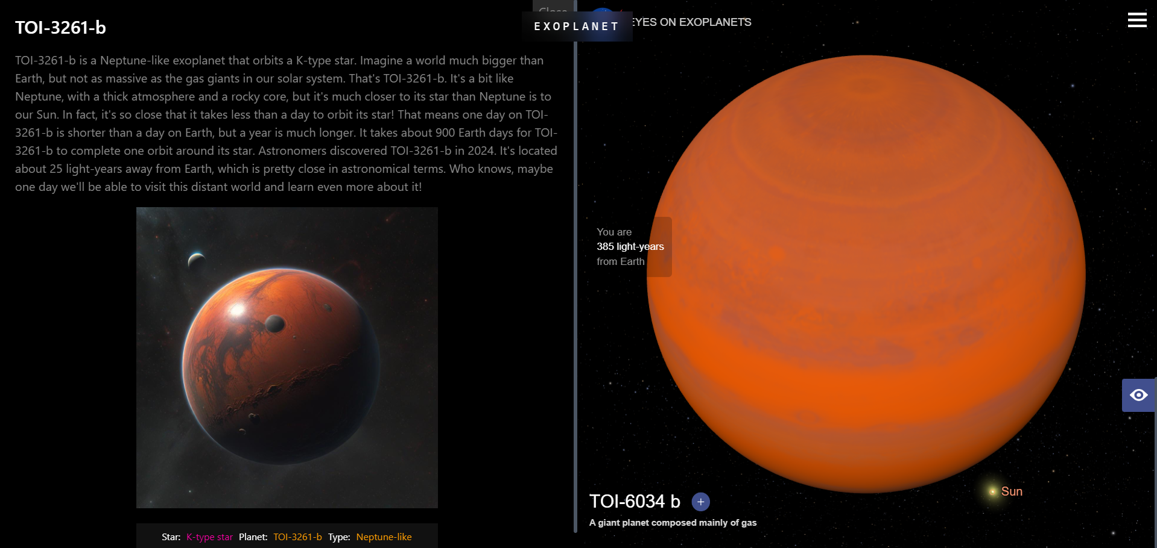
How to Detect Plant Biodiversity with EMIT?
Information of Exoplanet along with its 3D view

Slide 5
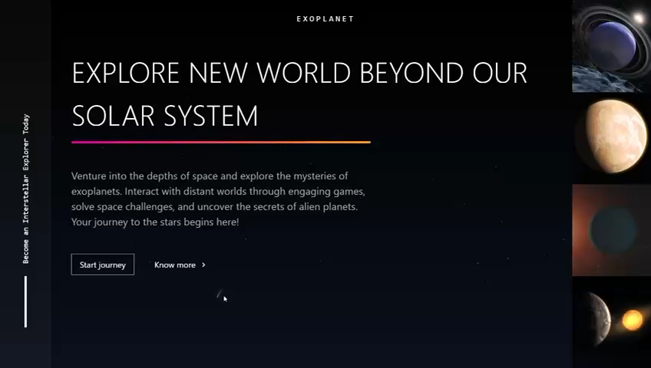
Website
https://www.antariksyatri.club/

Slide 6
Summary & Future Work
Summary
Application where user can search information related to exoplanets.
Has an inbuilt chatbot for quiz which further clears your doubts
Small exoplanet game along with funfact
Future Work
Fine-tuning our AI Model to make it capable to answer edge cases.
Deploying it using Cloud services to improve production quality.
Making it more engaging and education friendly

Slide 7

-Antarikṣ Yātrī 618

